Slide 1
Machine Learning for Non-Coders

Slide 2
Agenda
Overview of Machine Learning
Overview of Orange
Development History
Components of Orange
Widgets
Workflow
Case study
Lab
Q&A

Slide 3
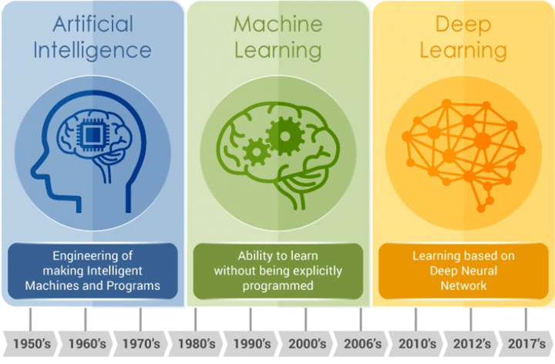
Machine Learning
Notes:
AI is the branch of Computer Sciences that emphasizes the development of intelligence machines, thinking and working like humans. For example, Speech Recognition, Image recognition, learning & planning.
Machine Learning is a branch of artificial intelligence and as defined by Computer Scientist and ML pioneer Tom M Mitchell. Machine Learning is the study of computer algorithms that allow computer programs to automatically improve through experience.
Deep Learning is a computer software that mimics the network of neurons in a brain. It is a subset of machine learning and is called deep learning because it makes use of deep neural network.
A Deep neural network is a neural network with a certain level of complexity, a neural network with multiple hidden layers. Deep refers to a model's layers being multiple layers deep.
An artificial neural network involves a network of simple processing elements (artificial neurons) which can exhibit complext global behavior, determined by the connections between the processing elements and element parameters.

Slide 4
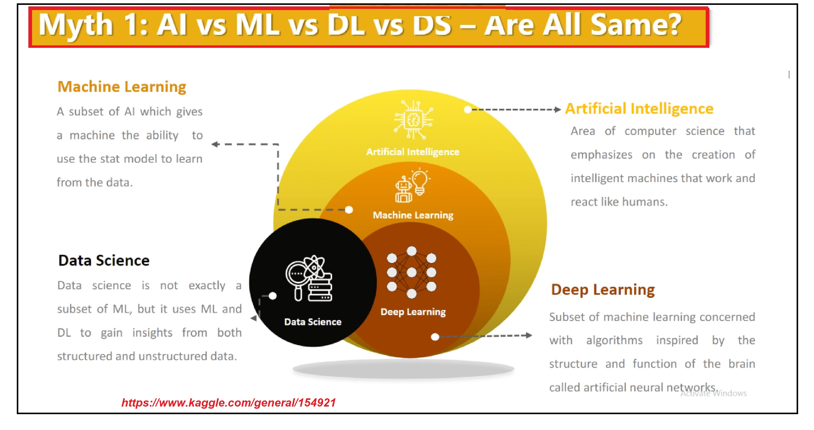
Machine Learning – Different flavours
Notes:
AI is the branch of Computer Sciences that emphasizes the development of intelligence machines, thinking and working like humans. For example, Speech Recognition, Image recognition, learning & planning.
Machine Learning is a branch of artificial intelligence and as defined by Computer Scientist and ML pioneer Tom M Mitchell. Machine Learning is the study of computer algorithms that allow computer programs to automatically improve through experience.
Deep Learning is a computer software that mimics the network of neurons in a brain. It is a subset of machine learning and is called deep learning because it makes use of deep neural network.
A Deep neural network is a neural network with a certain level of complexity, a neural network with multiple hidden layers. Deep refers to a model's layers being multiple layers deep.
An artificial neural network involves a network of simple processing elements (artificial neurons) which can exhibit complext global behavior, determined by the connections between the processing elements and element parameters.

Slide 5
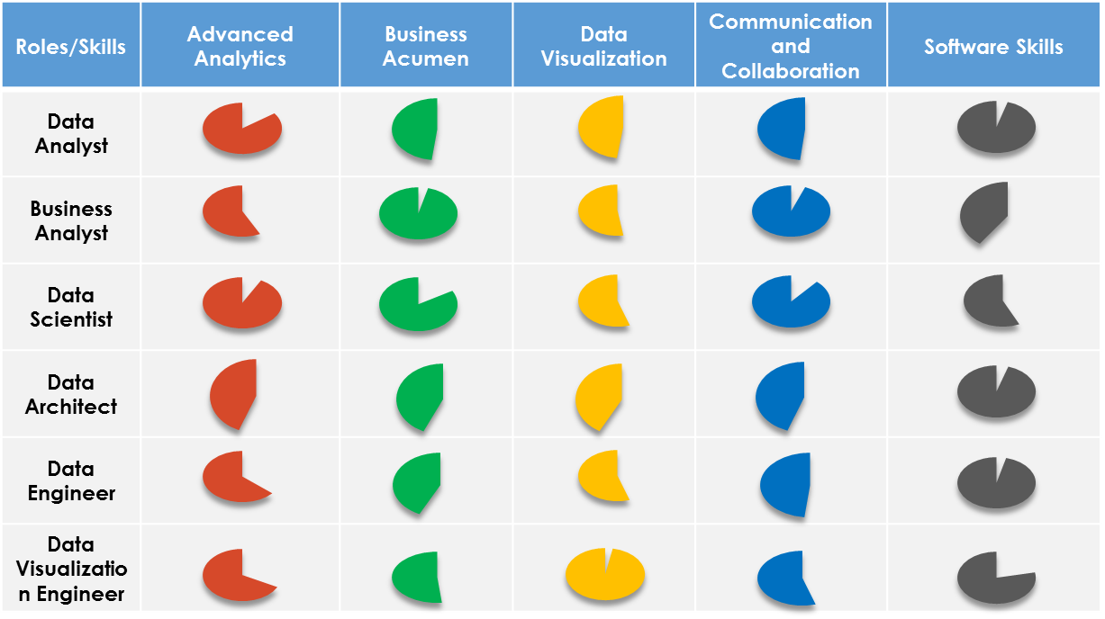
Machine Learning – Roles & Skills
Notes:
AI is the branch of Computer Sciences that emphasizes the development of intelligence machines, thinking and working like humans. For example, Speech Recognition, Image recognition, learning & planning.
Machine Learning is a branch of artificial intelligence and as defined by Computer Scientist and ML pioneer Tom M Mitchell. Machine Learning is the study of computer algorithms that allow computer programs to automatically improve through experience.
Deep Learning is a computer software that mimics the network of neurons in a brain. It is a subset of machine learning and is called deep learning because it makes use of deep neural network.
A Deep neural network is a neural network with a certain level of complexity, a neural network with multiple hidden layers. Deep refers to a model's layers being multiple layers deep.
An artificial neural network involves a network of simple processing elements (artificial neurons) which can exhibit complext global behavior, determined by the connections between the processing elements and element parameters.

Slide 6


















Machine Learning – Tools
Notes:
AI is the branch of Computer Sciences that emphasizes the development of intelligence machines, thinking and working like humans. For example, Speech Recognition, Image recognition, learning & planning.
Machine Learning is a branch of artificial intelligence and as defined by Computer Scientist and ML pioneer Tom M Mitchell. Machine Learning is the study of computer algorithms that allow computer programs to automatically improve through experience.
Deep Learning is a computer software that mimics the network of neurons in a brain. It is a subset of machine learning and is called deep learning because it makes use of deep neural network.
A Deep neural network is a neural network with a certain level of complexity, a neural network with multiple hidden layers. Deep refers to a model's layers being multiple layers deep.
An artificial neural network involves a network of simple processing elements (artificial neurons) which can exhibit complext global behavior, determined by the connections between the processing elements and element parameters.

Slide 7
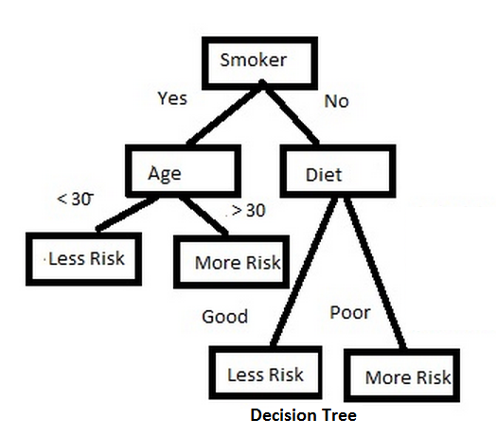
Machine Learning – Popular algorithms
Classification Algorithm
Classification algorithms enable you to model categorical response variable as a function of one or more predictors.
Decision Tree learning is the construction of a decision tree from class-labeled training tuples.
A decision tree is a flow-chart like structure, where each internal (non-leaf) node denotes a test on an attribute, each branch represents the outcome of a test, and each leaf (or terminal) node holds a class label. The topmost node in a tree is the root node.
Notes:
AI is the branch of Computer Sciences that emphasizes the development of intelligence machines, thinking and working like humans. For example, Speech Recognition, Image recognition, learning & planning.
Machine Learning is a branch of artificial intelligence and as defined by Computer Scientist and ML pioneer Tom M Mitchell. Machine Learning is the study of computer algorithms that allow computer programs to automatically improve through experience.
Deep Learning is a computer software that mimics the network of neurons in a brain. It is a subset of machine learning and is called deep learning because it makes use of deep neural network.
A Deep neural network is a neural network with a certain level of complexity, a neural network with multiple hidden layers. Deep refers to a model's layers being multiple layers deep.
An artificial neural network involves a network of simple processing elements (artificial neurons) which can exhibit complext global behavior, determined by the connections between the processing elements and element parameters.

Slide 8
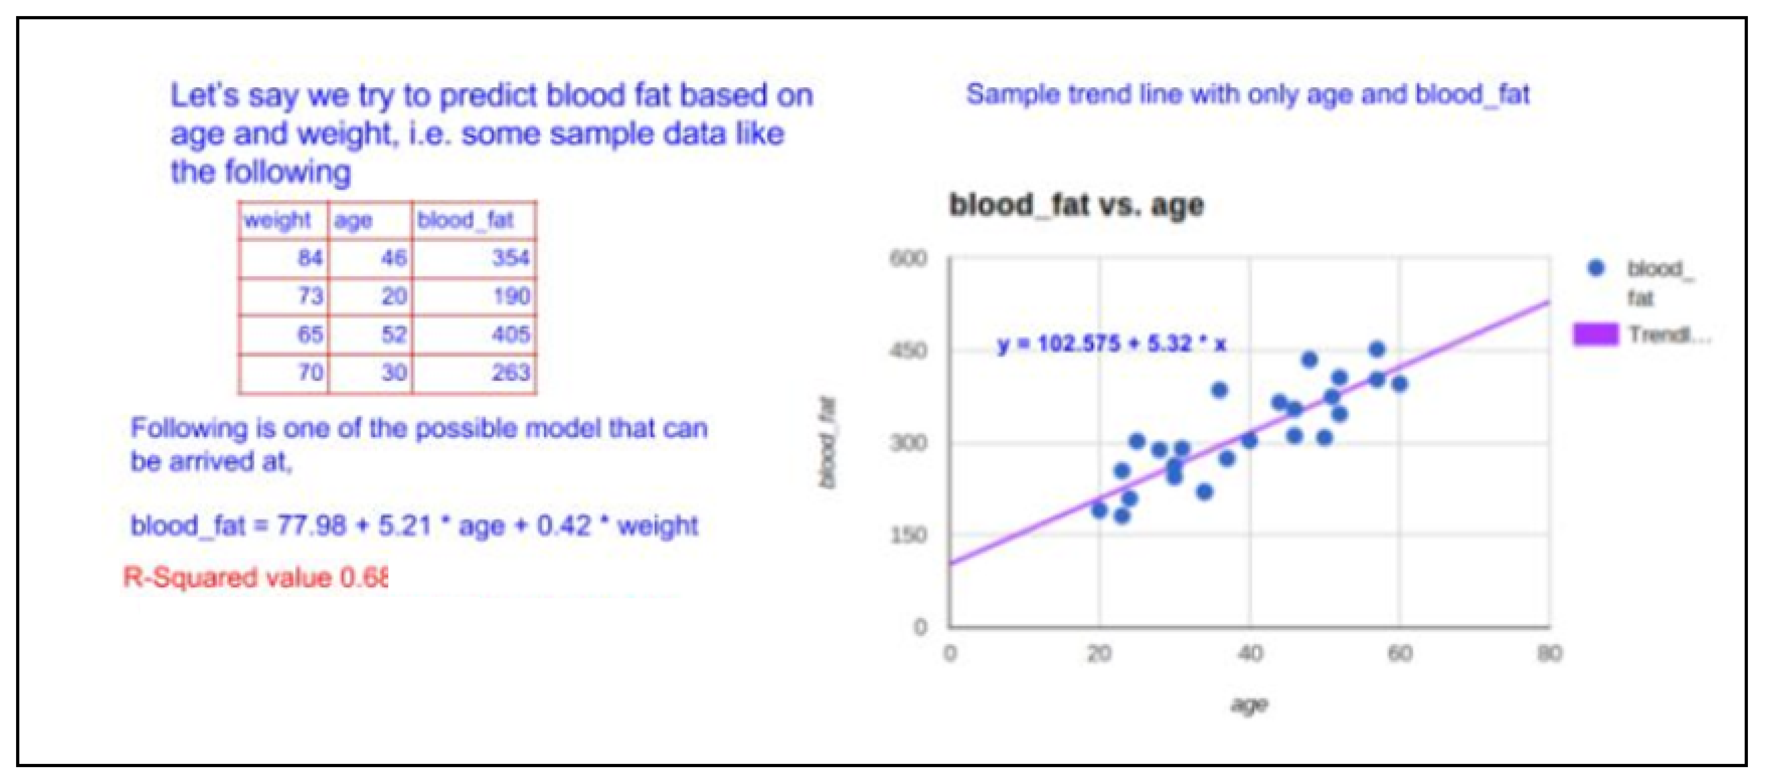
Machine Learning – Popular algorithms
Regression Algorithm
Regression is a technique used to predict a range of numeric values (also called continuous values), given a particular dataset.
Notes:
AI is the branch of Computer Sciences that emphasizes the development of intelligence machines, thinking and working like humans. For example, Speech Recognition, Image recognition, learning & planning.
Machine Learning is a branch of artificial intelligence and as defined by Computer Scientist and ML pioneer Tom M Mitchell. Machine Learning is the study of computer algorithms that allow computer programs to automatically improve through experience.
Deep Learning is a computer software that mimics the network of neurons in a brain. It is a subset of machine learning and is called deep learning because it makes use of deep neural network.
A Deep neural network is a neural network with a certain level of complexity, a neural network with multiple hidden layers. Deep refers to a model's layers being multiple layers deep.
An artificial neural network involves a network of simple processing elements (artificial neurons) which can exhibit complext global behavior, determined by the connections between the processing elements and element parameters.

Slide 9
Machine Learning – Tools - KNIME
KNIME, The Konstanz Information Miner, is a free and open-source data analytics, reporting and integration platform.
KNIME integrates various components for machine learning and data mining through its modular data pipelining concept.
A graphical user interface and use of JDBC allows assembly of nodes blending different data sources, including preprocessing (ETL: Extraction, Transformation, Loading), for modeling, data analysis and visualization without, or with only minimal, programming.
It is developed by KNIME AG located in Zurich and the group of Michael Berthold at the University of Konstanz, Chair for Bioinformatics and Information Mining.
KNIME allows users to visually create data flows (or pipelines), selectively execute some or all analysis steps, and later inspect the results, models, using interactive widgets and views.
KNIME is written in Java and based on Eclipse. It makes use of extension mechanism to add plugins providing additional functionality.
Ref:
https://en.wikipedia.org/wiki/KNIME
https://www.knime.com/faq
Notes:
AI is the branch of Computer Sciences that emphasizes the development of intelligence machines, thinking and working like humans. For example, Speech Recognition, Image recognition, learning & planning.
Machine Learning is a branch of artificial intelligence and as defined by Computer Scientist and ML pioneer Tom M Mitchell. Machine Learning is the study of computer algorithms that allow computer programs to automatically improve through experience.
Deep Learning is a computer software that mimics the network of neurons in a brain. It is a subset of machine learning and is called deep learning because it makes use of deep neural network.
A Deep neural network is a neural network with a certain level of complexity, a neural network with multiple hidden layers. Deep refers to a model's layers being multiple layers deep.
An artificial neural network involves a network of simple processing elements (artificial neurons) which can exhibit complext global behavior, determined by the connections between the processing elements and element parameters.

Slide 10
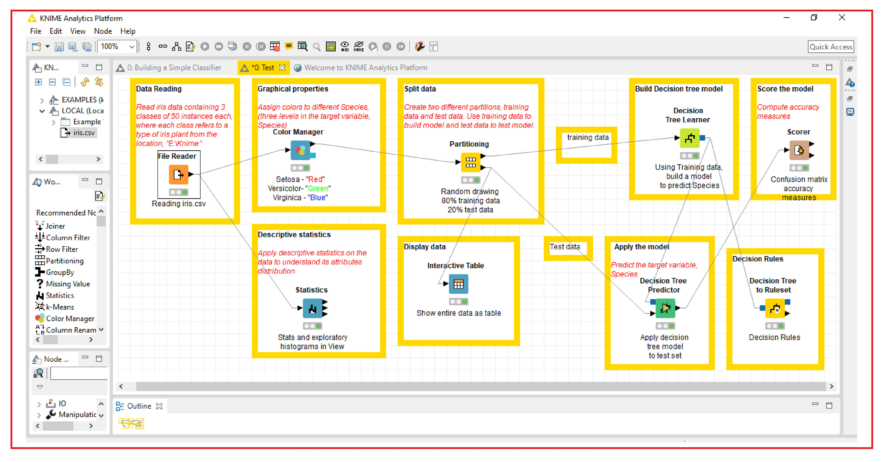
Machine Learning – KNIME WORKFLOW
Notes:
AI is the branch of Computer Sciences that emphasizes the development of intelligence machines, thinking and working like humans. For example, Speech Recognition, Image recognition, learning & planning.
Machine Learning is a branch of artificial intelligence and as defined by Computer Scientist and ML pioneer Tom M Mitchell. Machine Learning is the study of computer algorithms that allow computer programs to automatically improve through experience.
Deep Learning is a computer software that mimics the network of neurons in a brain. It is a subset of machine learning and is called deep learning because it makes use of deep neural network.
A Deep neural network is a neural network with a certain level of complexity, a neural network with multiple hidden layers. Deep refers to a model's layers being multiple layers deep.
An artificial neural network involves a network of simple processing elements (artificial neurons) which can exhibit complext global behavior, determined by the connections between the processing elements and element parameters.

Slide 11

Orange, an opensource tool
Orange is an open source tool which provides machine learning and data visualization capabilities for novice and expert users through visual programming or Python scripting.
You can install Orange
After downloading it from https://orange.biolab.si/download/
Install from the Python package index by using pip command if you are using Python provided by Anaconda distribution. https://orange.biolab.si/download/#windows

Slide 12
Development History
1996 Development of ML, a machine learning framework in C++ started by University of Ljubljana and Jožef Stefan Institute -
1997 - Python bindings were developed for ML, which together with emerging Python modules formed a joint framework, Orange
2002 - First prototypes to create a flexible graphical user interface were designed
2003 - Visual programming framework defined, and development of widgets began
2005 - Extends data analysis in bioinformatics
2008 - Installation packages were developed
2009 - Over 100 widgets were created and maintained

Slide 13

Components
Orange screen shot
Orange consists of a canvas interface onto which the user places widgets and create a data analysis workflow.
Canvas: Graphical front-end for data analysis
Widgets: Components in Orange Canvas, a visual programming environment of Orange.

Slide 14
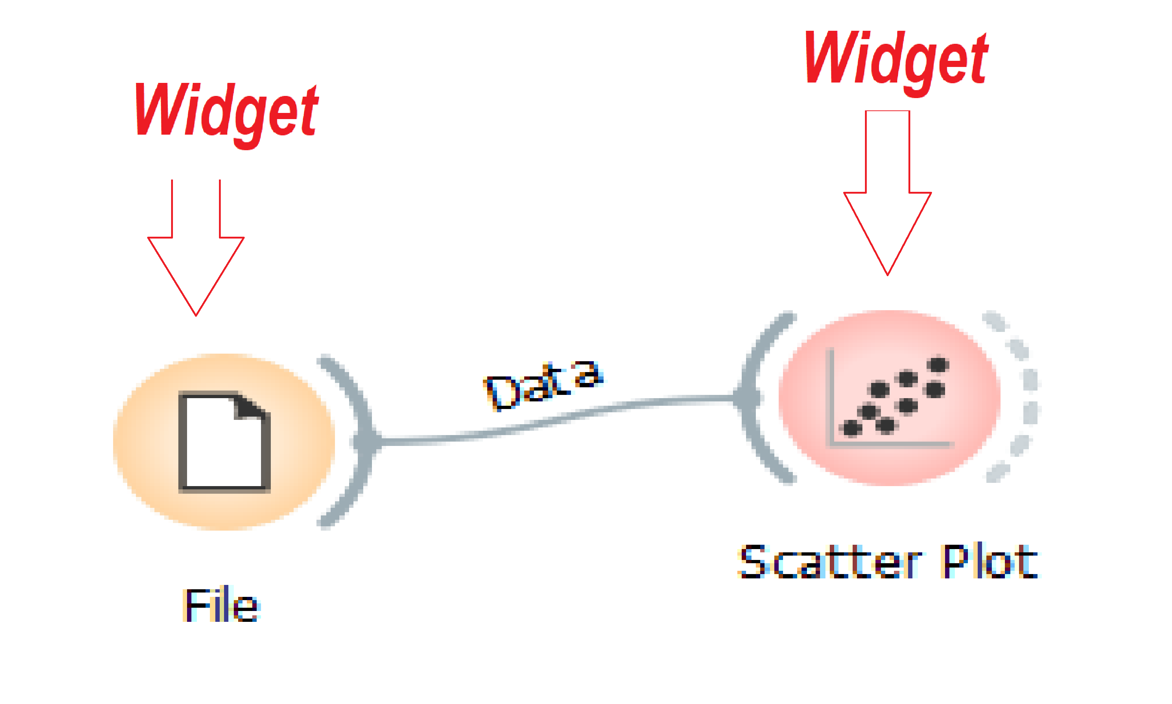
Widgets
Widgets are grouped into classes according to their function.
Class | Widgets - examples
Data | File, Select attributes, Merge Data, Outliers
Visualize | Scatter Plot, Distributions
Classify | SVM learner, Classification Tree Learner, Random Forest, Logistic Regression Learner
Regression | Linear Regression Learner, Regression Tree Learner
Evaluate | Confusion Matrix, ROC analysis, Prediction
Associate | Association Rules, Item Sets, Association Rules Tree Viewer
Unsupervised | Principal Component Analysis, K-Means clustering, Hierarchical clustering
Workflow sample using pre-defined widgets
We can add more widgets from the add-ons such widgets for working with images and ImageNet embeddings under the class Image analytics, widgets for NLP and text mining under the class Text mining etc.
For widget catalog: https://orange.biolab.si/widget-catalog/

Slide 15
Workflow
A workflow is the sequence of steps or actions that you take in your platform to accomplish a particular task.
Workflows are created by linking predefined or user-designed widgets
There are many Orange workflow examples such as File and Data Table, Interactive Visualizations, Visualization of Data Subsets, Classification Tree, PCA, Hierarchical clustering, Feature Ranking etc.
.
Ref: https://www.analyticsvidhya.com/blog/2017/09/building-machine-learning-model-fun-using-orange/

Slide 16
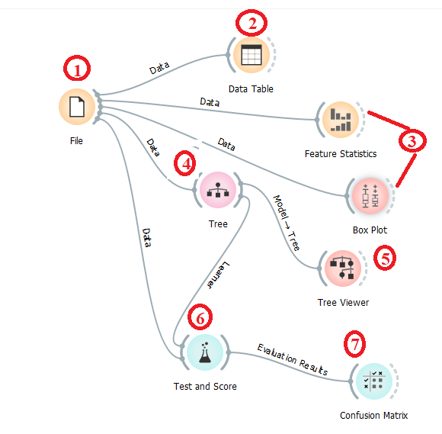
Case study 1
Steps in Orange workflow for predicting Species of iris dataset:
The data set contains 3 classes (Setosa, Versicolour & Virginica) of 50 instances each, where each class refers to a type of iris plant.
1. Choose class-labelled data set "iris.tab" - File widget
2. View the dataset - Data Table widget
3. See data summary - Feature Statistics widget
Distribution of features - Box Plot widget
4. Build Model - Tree widget
5. View tree - Tree Viewer widget
6. Split data and predict - Test & score widget
7. Evaluation results - Confusion Matrix widget
8. Save the workflow as “iris-classification.ows” for later use

Slide 17
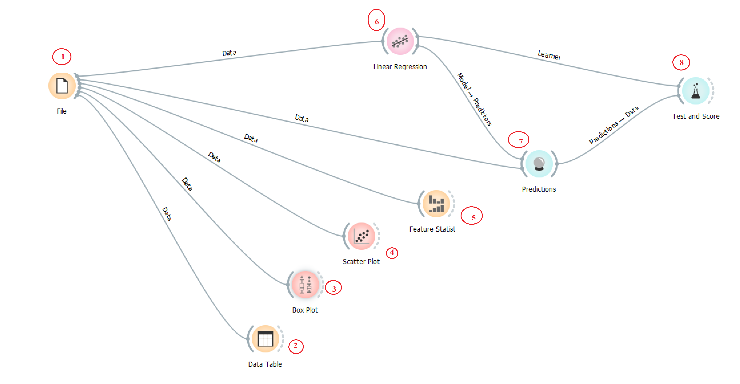
Case study 2
Boston is a database with information of areas around Boston city, and the median house prices. We will use linear regression in Orange to predict the house prices.
1. Choose class-labelled data set “housing.tab" - File widget
2. View the dataset - Data Table widget
3 & 4. See data summary
3. Distribution of features - Box Plot widget
4. Scatter plot – Scatter Plot widget
5. Understand features summary - Feature Statistics widget
6. Build Model – Linear Regression widget
7. Predict new data- Predictions widget
8. Evaluate performance - Test & score widget
9. Save the workflow as “crim-tab.ows” for later use

Slide 18
Lab session

Slide 19
References
https://en.wikipedia.org/wiki/Orange_(software)
https://www.youtube.com/channel/UClKKWBe2SCAEyv7ZNGhIe4g
https://www.analyticsvidhya.com/blog/2017/09/building-machine-learning-model-fun-using-orange/
http://www.csc.villanova.edu/~map/4510/orange/orangeintro.html
https://saifkabirasif.com/2019/05/25/Orange3_Tutorial/
https://www.orange83.com/video-series/premiereprobasics/
https://www.slideshare.net/kishoj/manual-orange-11438235

Slide 20
Q&A

